Slide 1
ne_core_5wtiv
NE Core Scenario
Add 3 WTIV

Slide 2
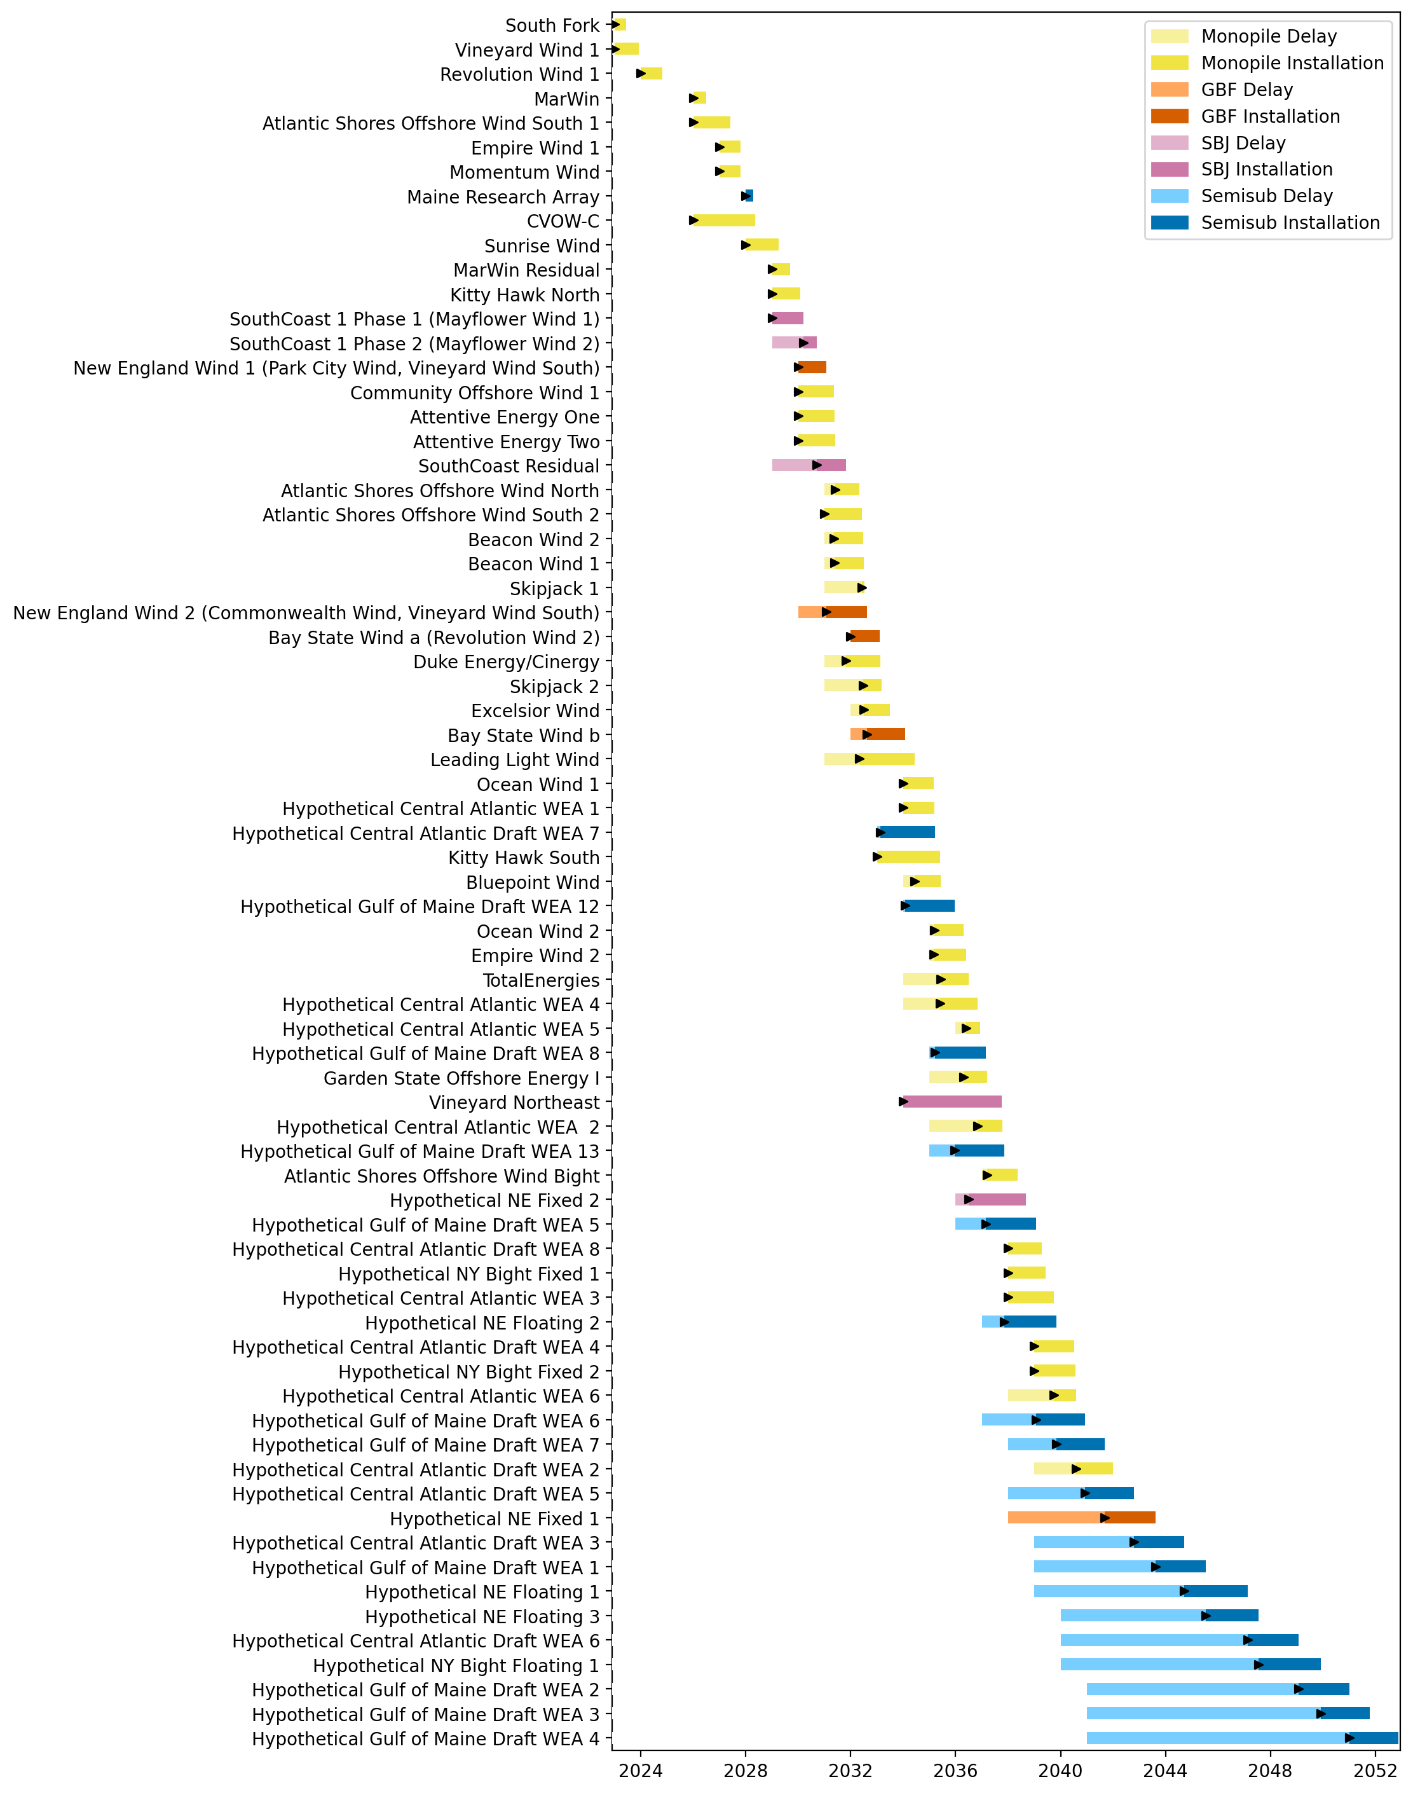
Full Gantt

Slide 3
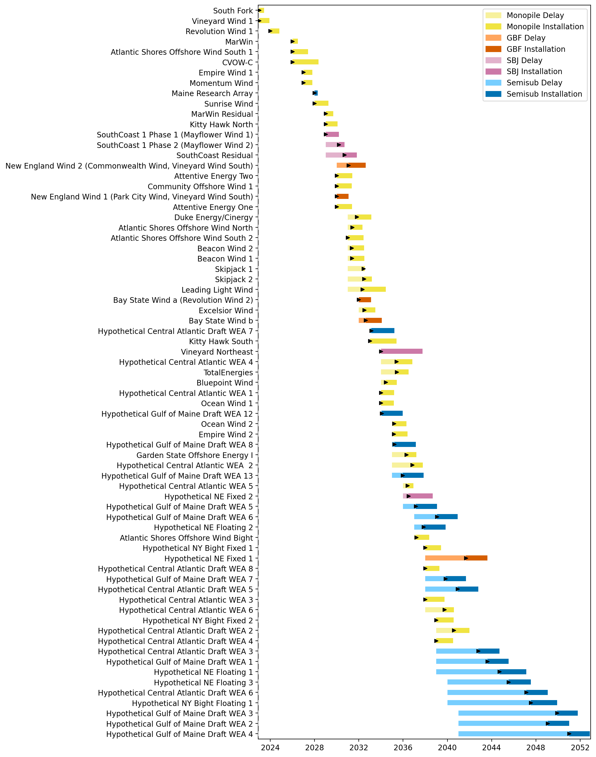
Sorted Full Gantt

Slide 4
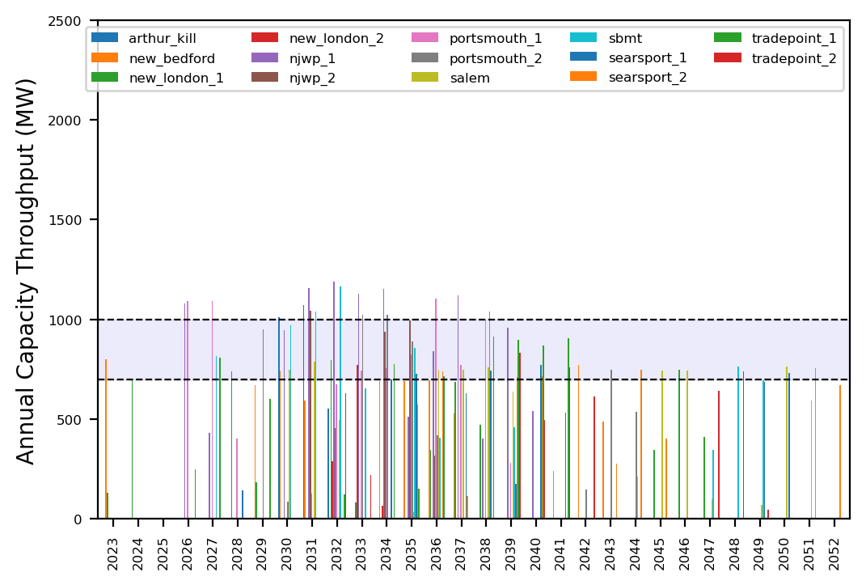
Port Throughput

Slide 5
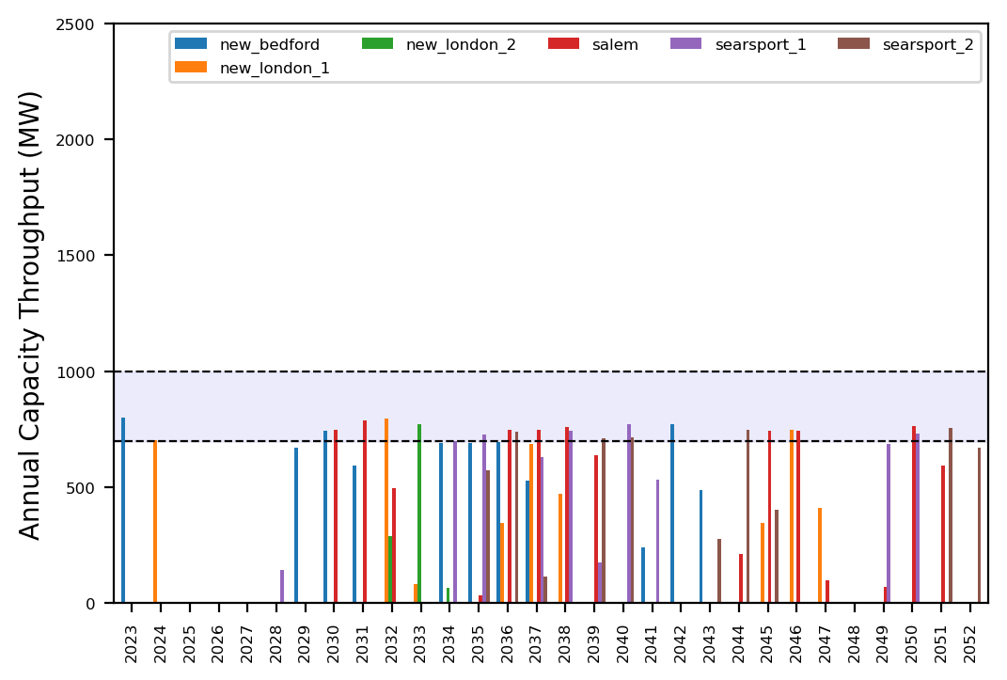
Port Throughput

Slide 6
ne_core_5wtiv_add_1_ahts
NE Core Scenario
Add 3 WTIV
Add 1 AHTS

Slide 7
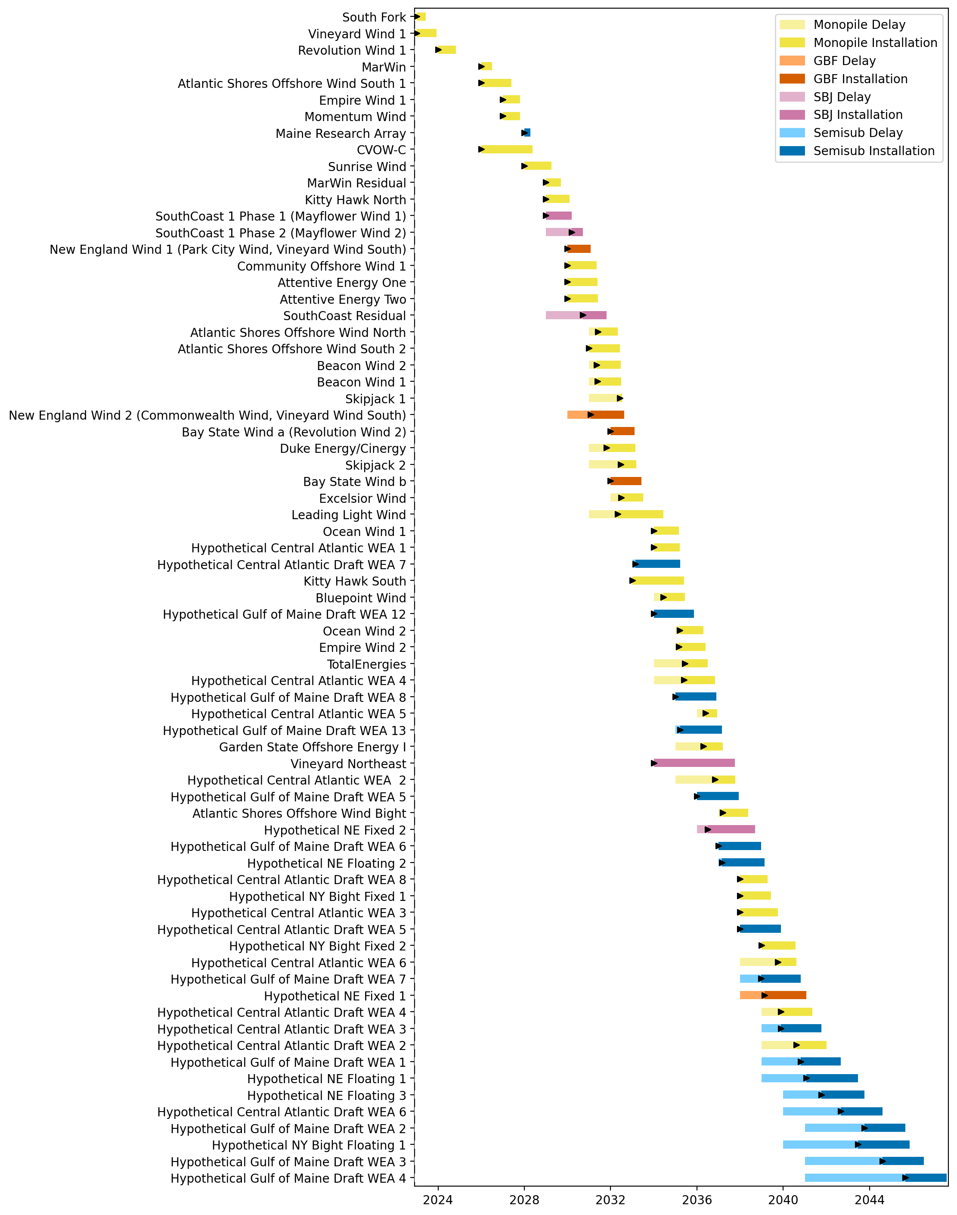
Full Gantt

Slide 8
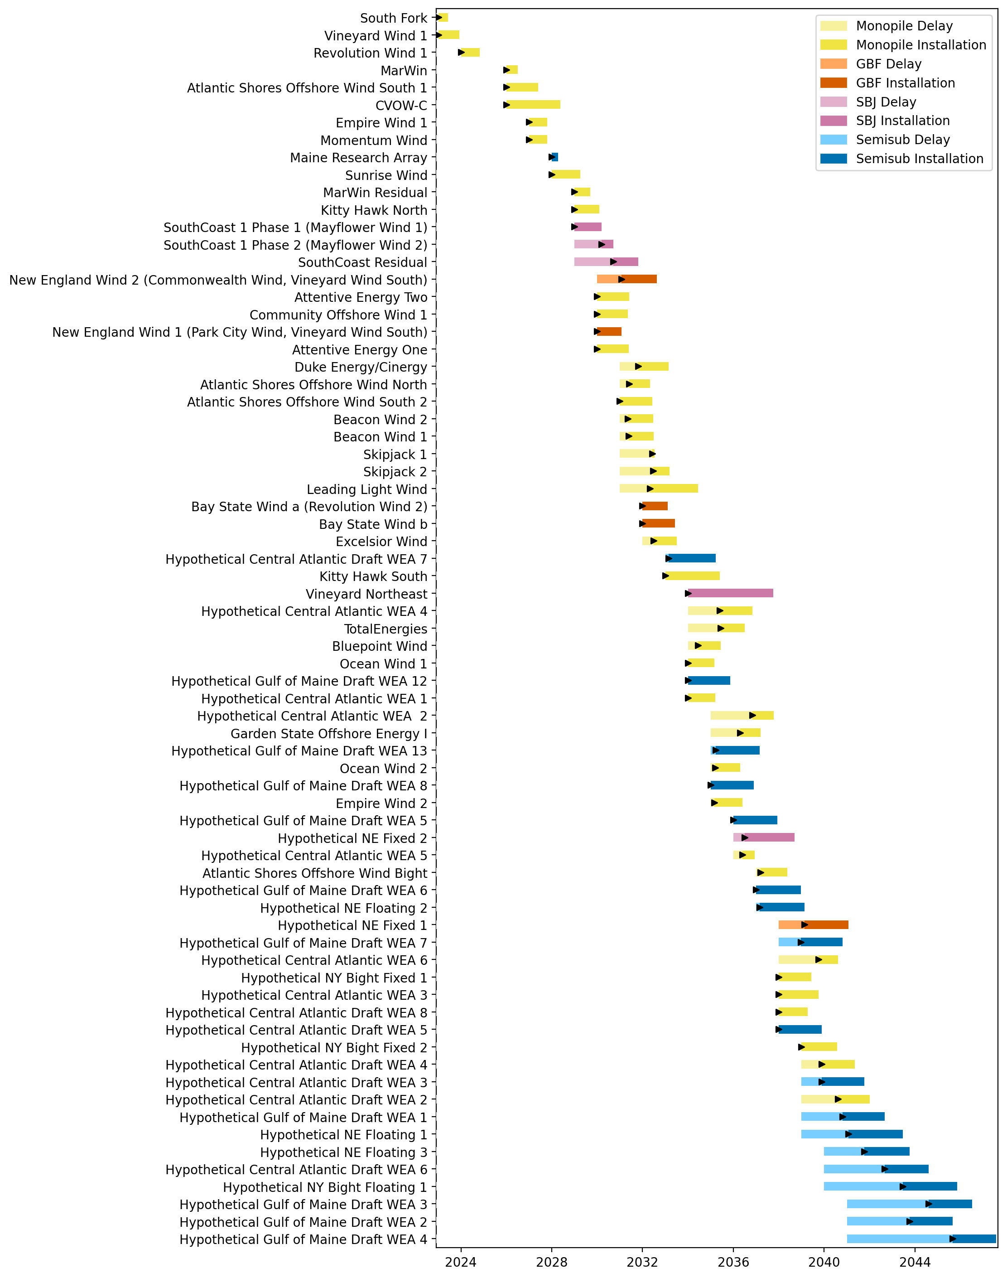
Sorted Full Gantt

Slide 9
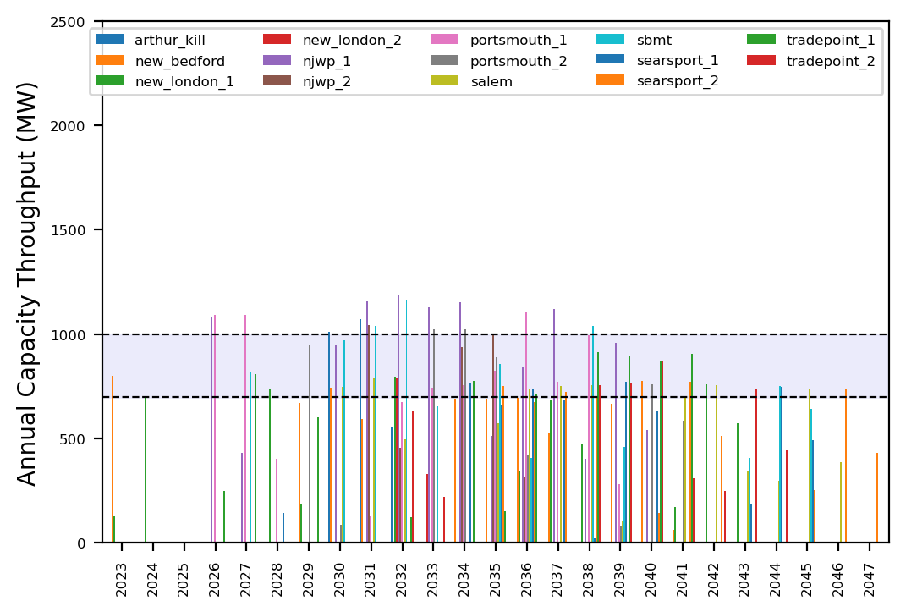
Port Throughput

Slide 10
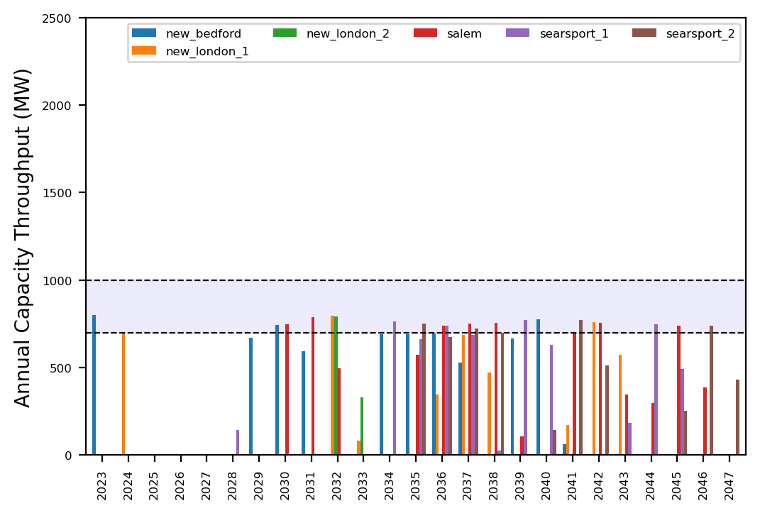
Port Throughput

Slide 11
ne_core_5wtiv_add_2_ahts
NE Core Scenario
Add 3 WTIV
Add 2 AHTS

Slide 12
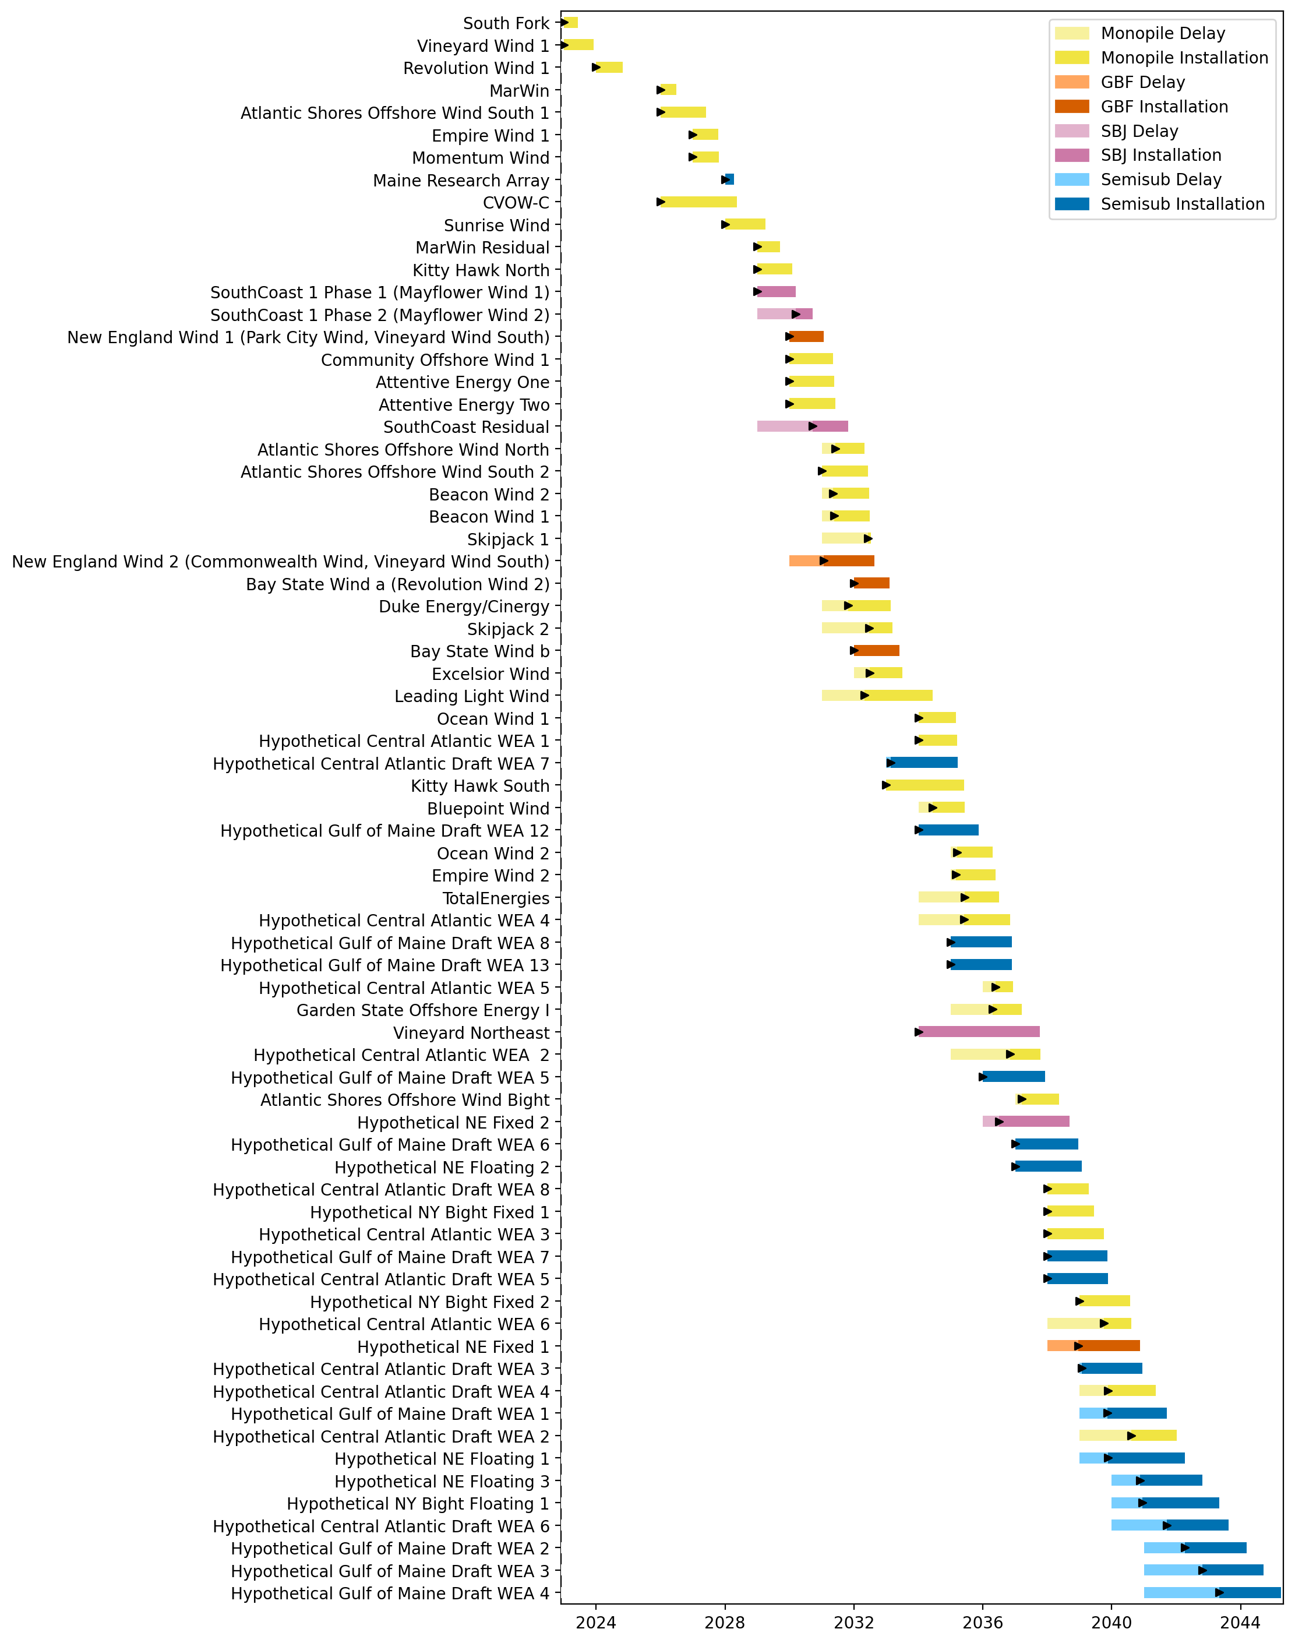
Full Gantt

Slide 13
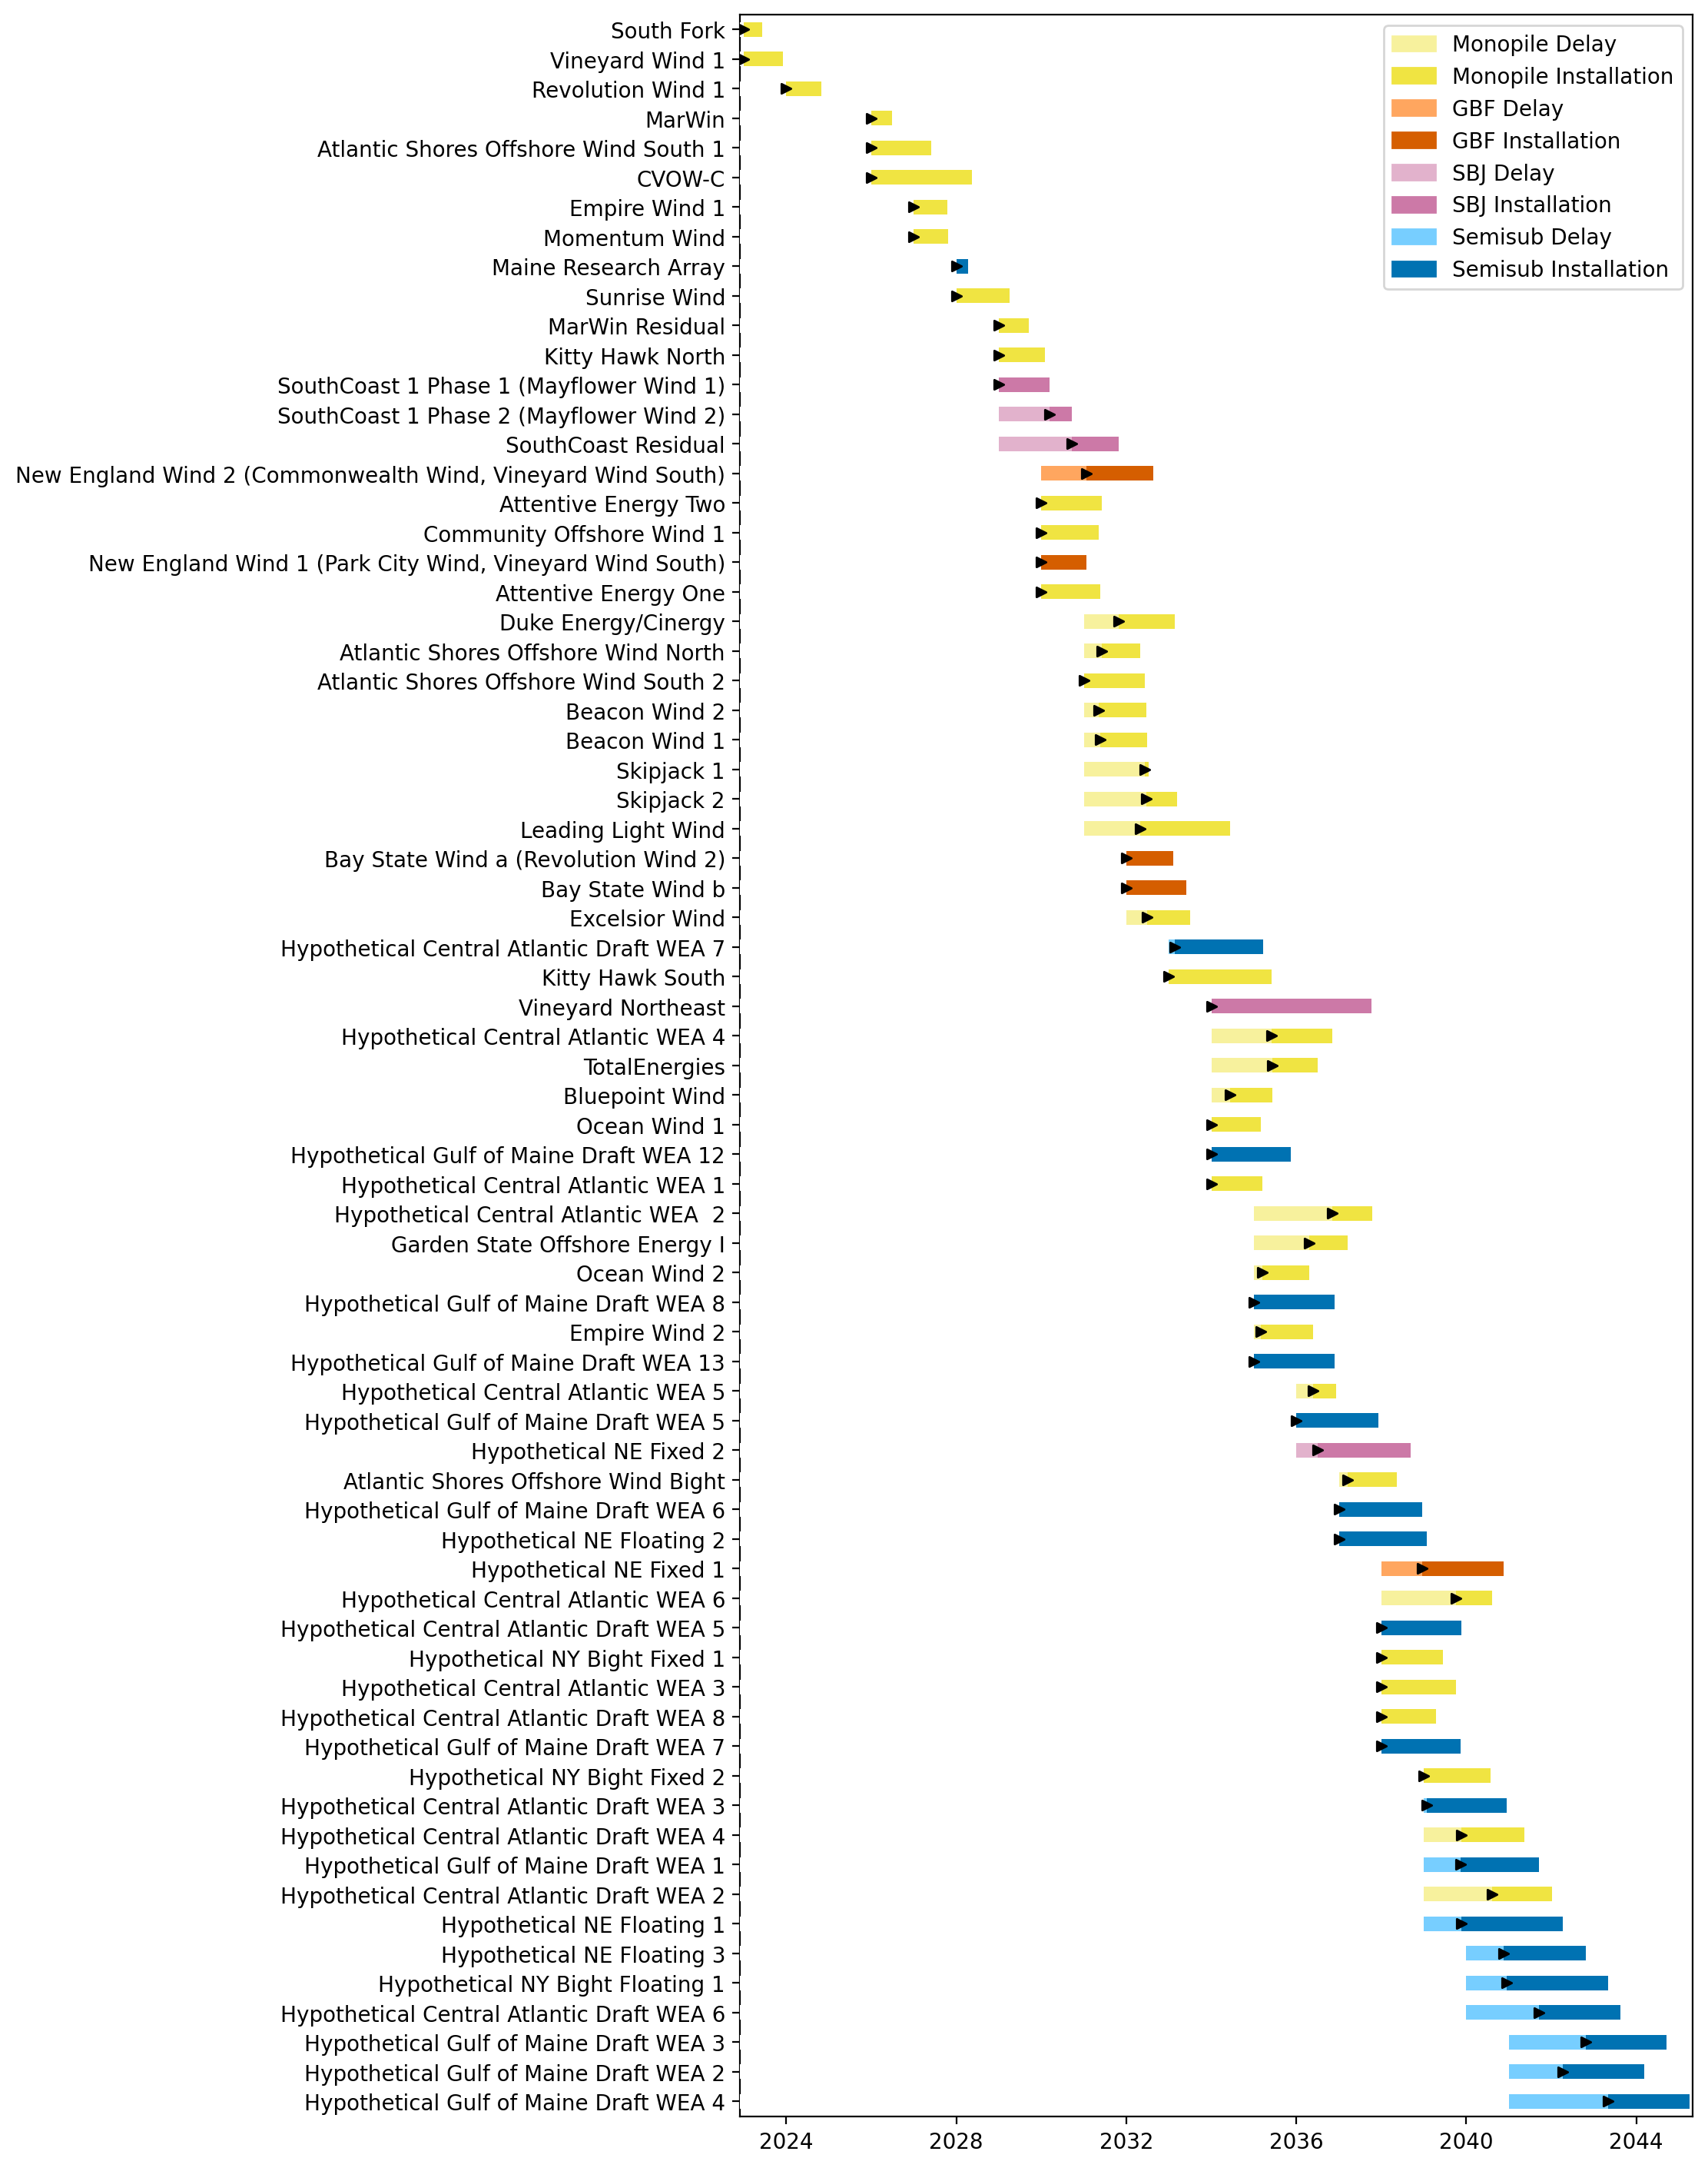
Sorted Full Gantt

Slide 14
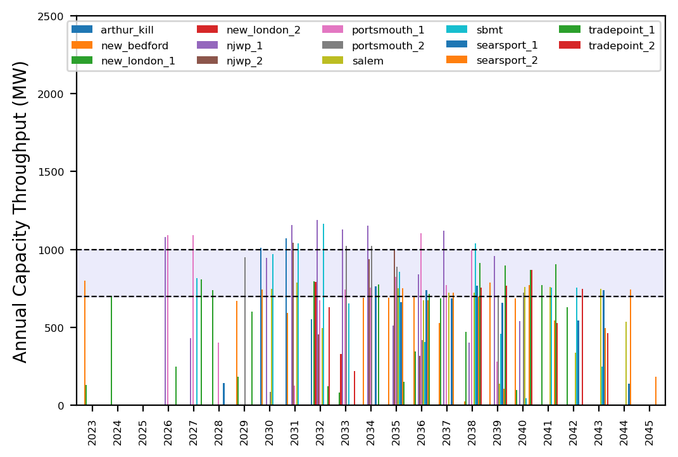
Port Throughput

Slide 15
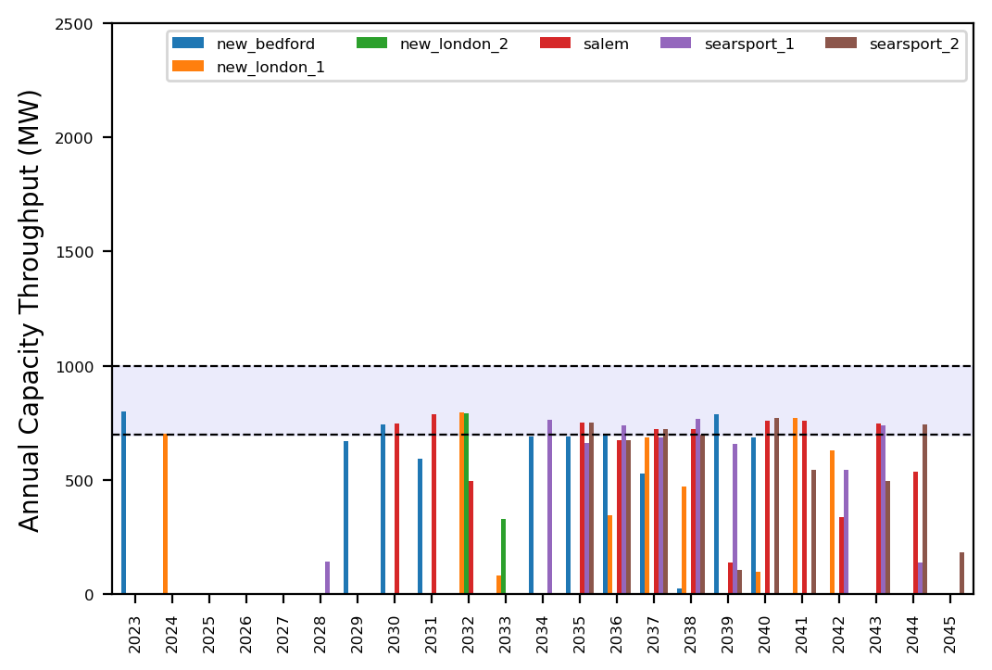
Port Throughput

Slide 16
ne_core_5wtiv_add_3_ahts
NE Core Scenario
Add 3 WTIV
Add 3 AHTS

Slide 17
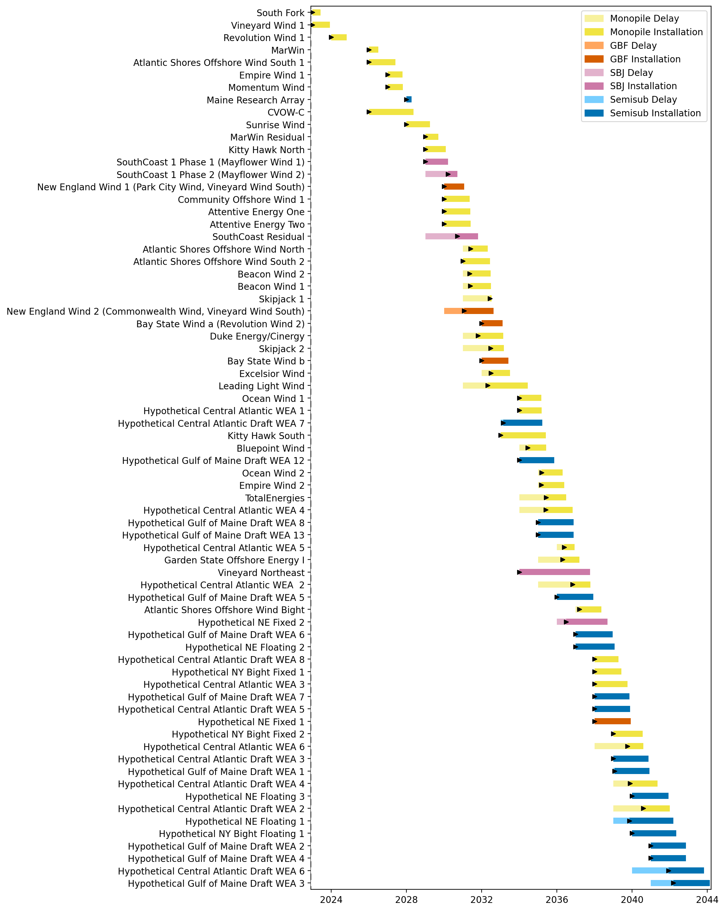
Full Gantt

Slide 18
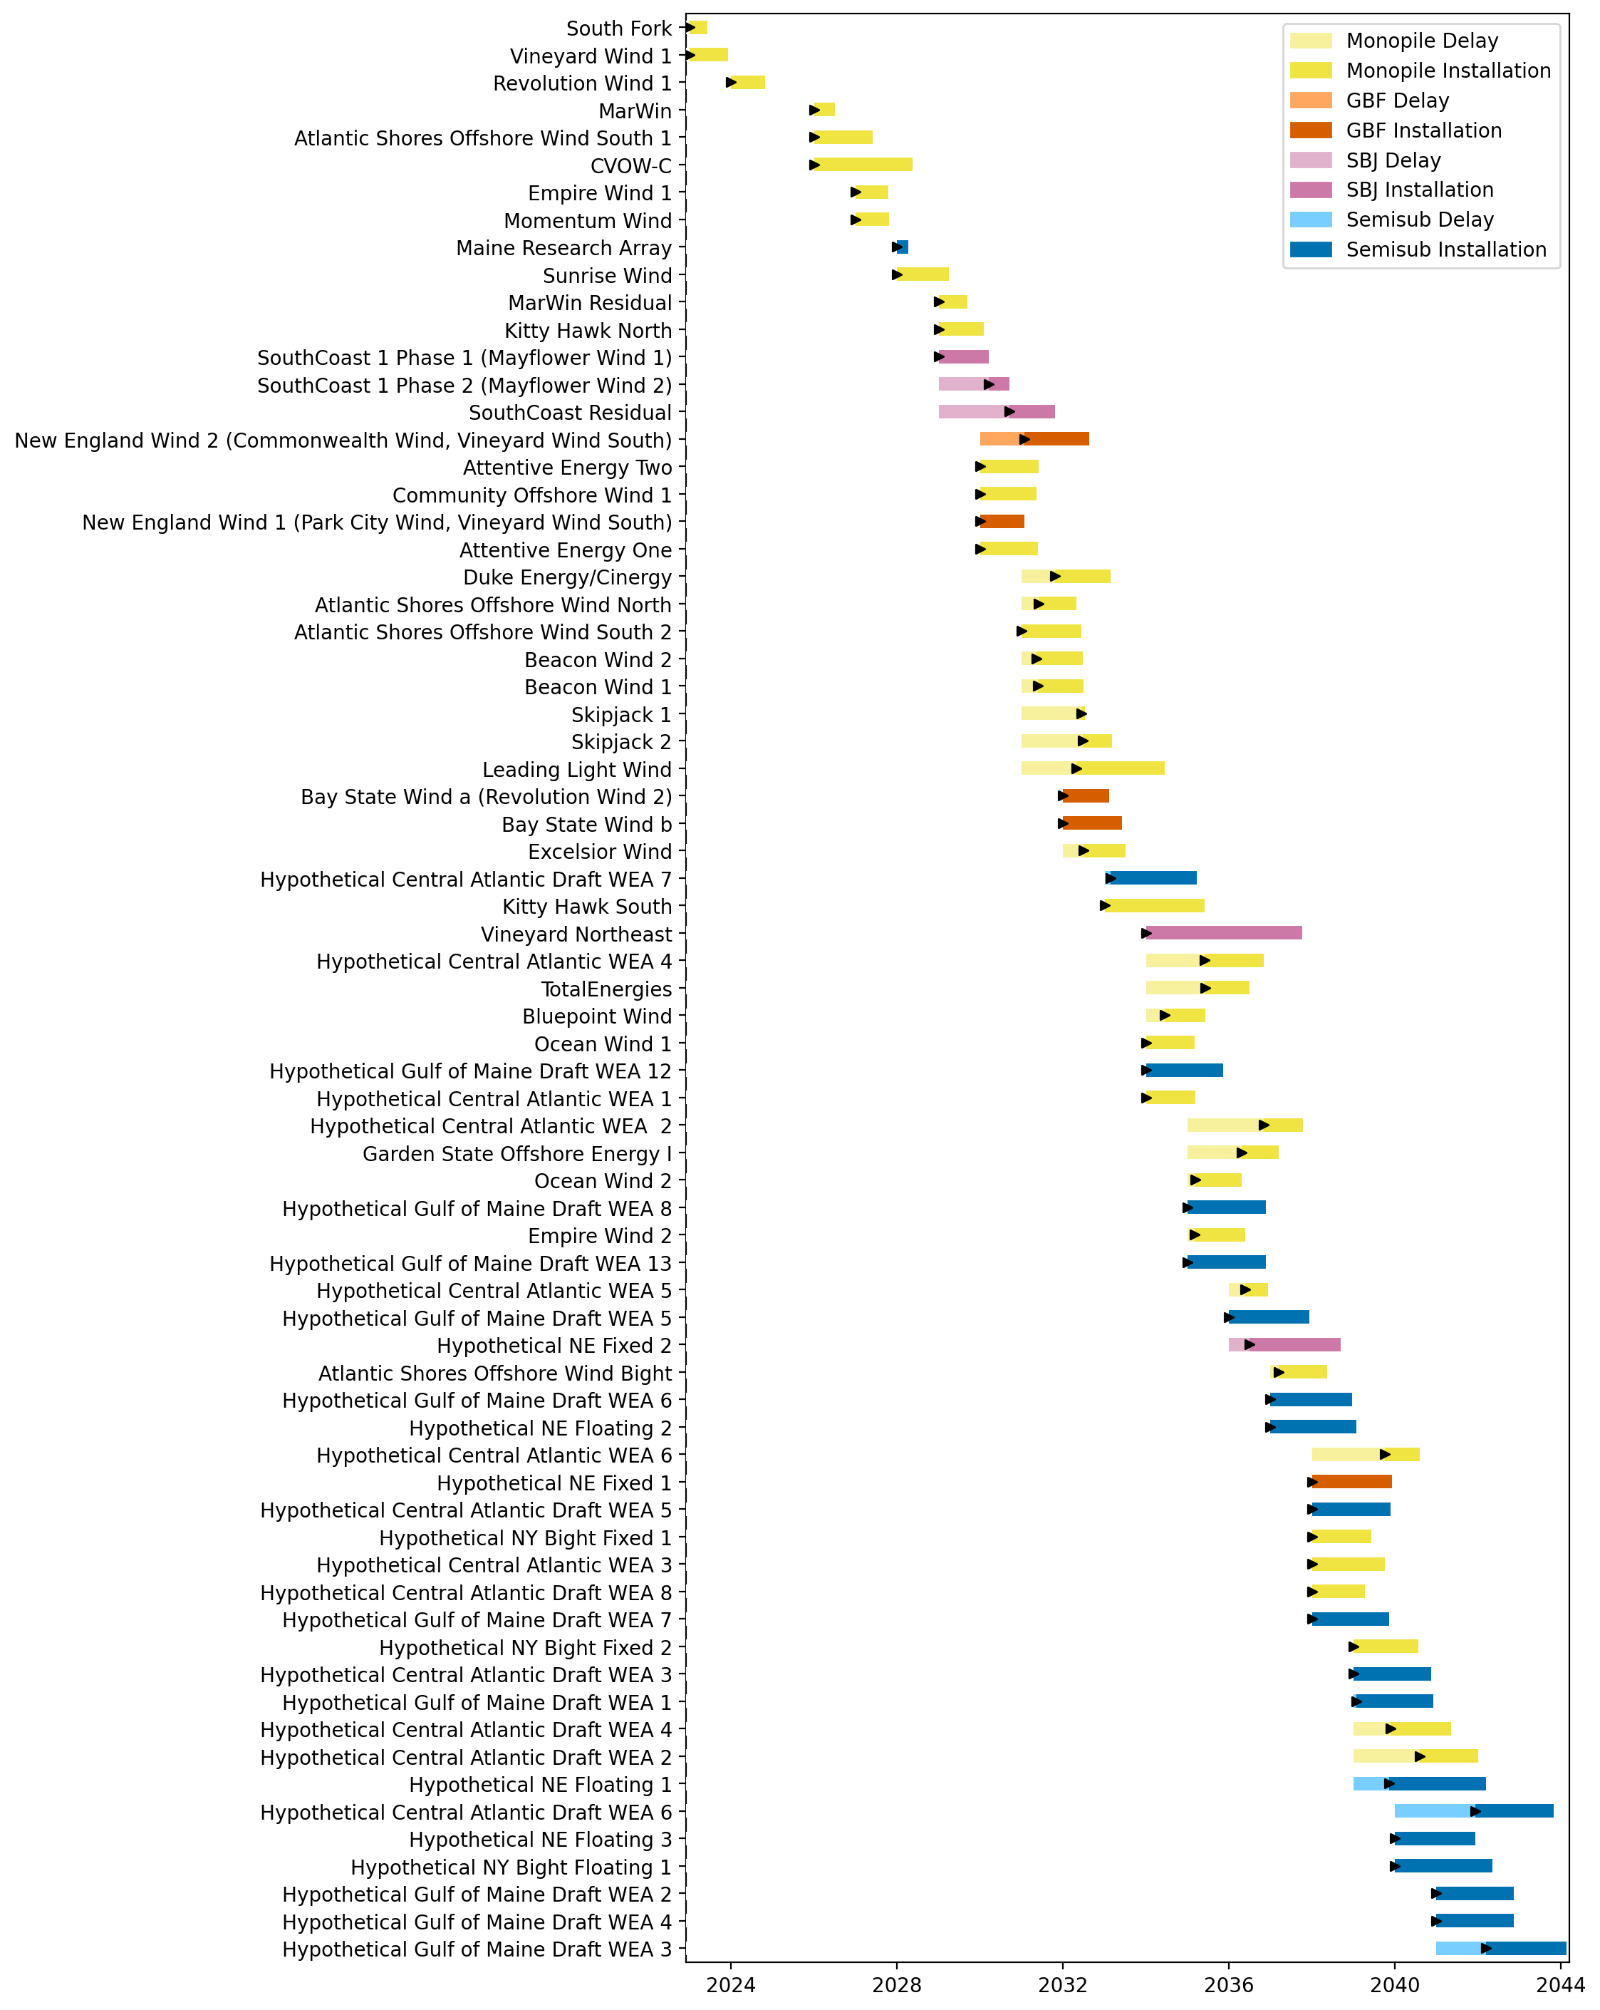
Sorted Full Gantt

Slide 19
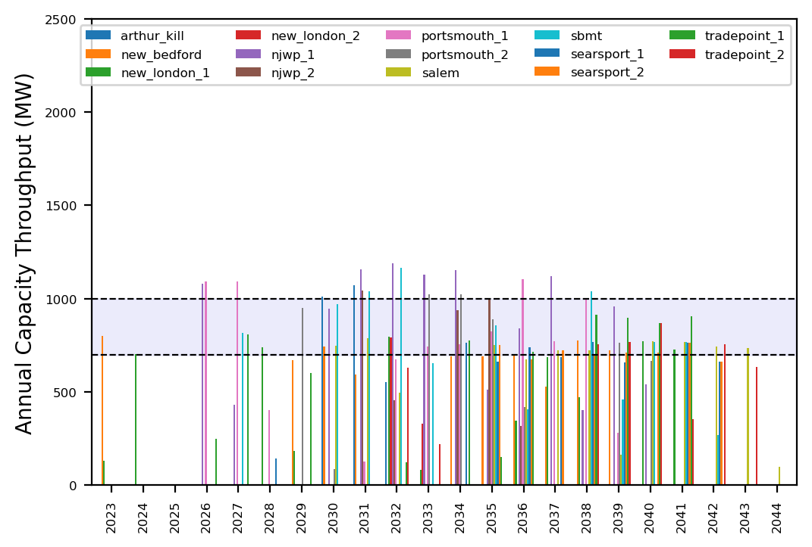
Port Throughput

Slide 20
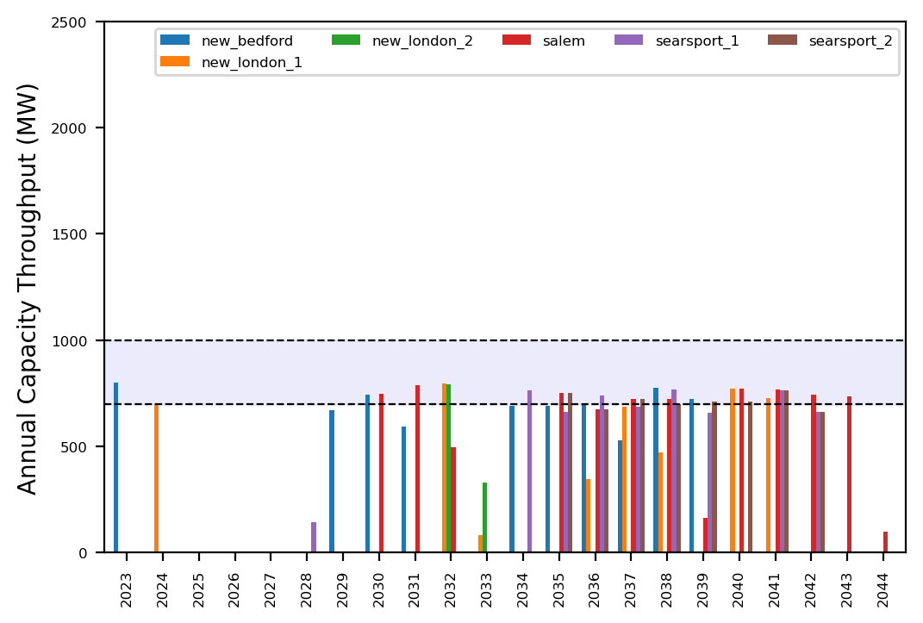
Port Throughput

Slide 21
ne_core_5wtiv_add_4_ahts
NE Core Scenario
Add 3 WTIV
Add 4 AHTS

Slide 22
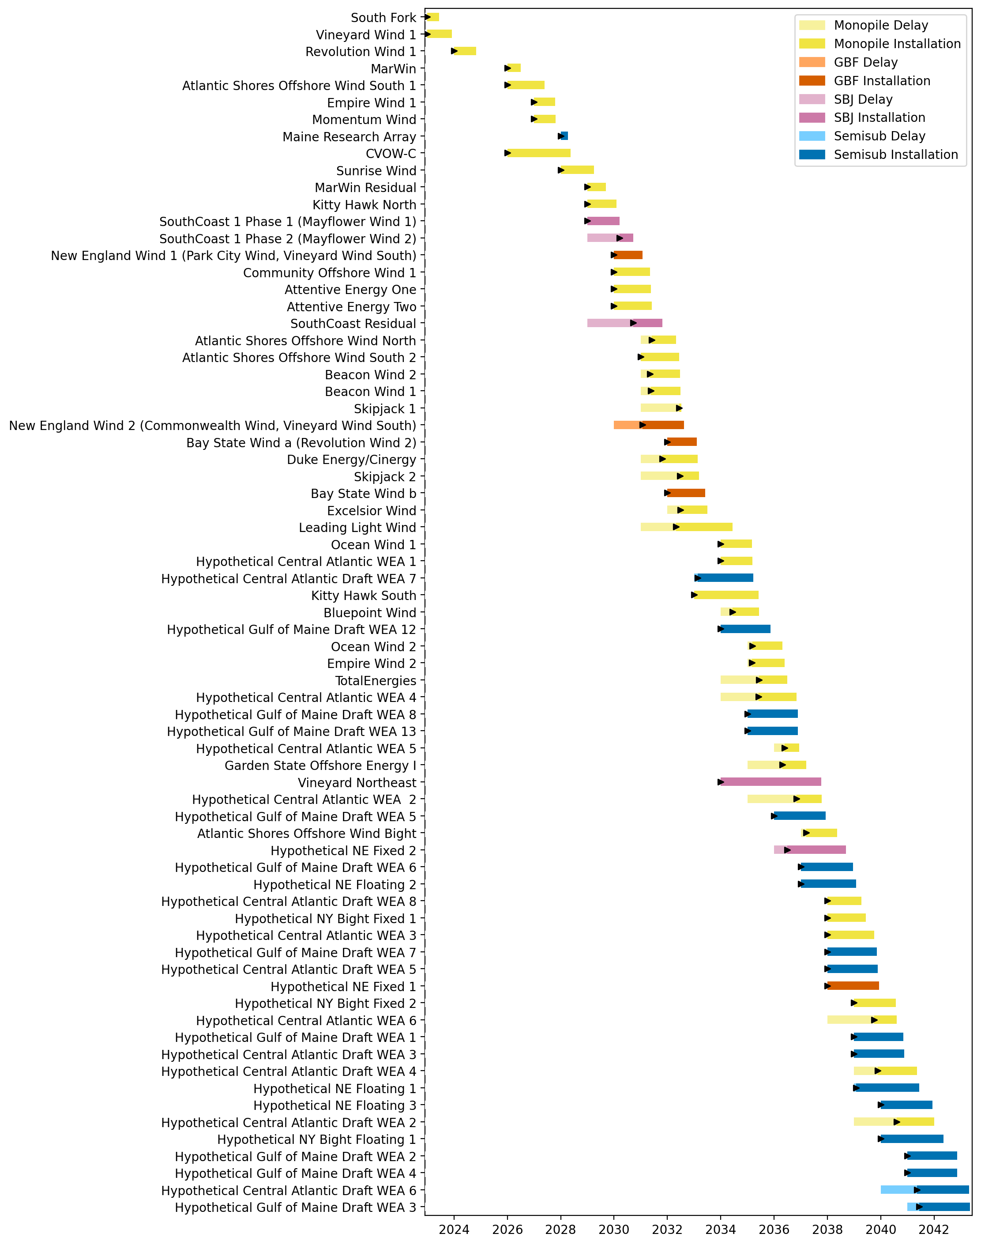
Full Gantt

Slide 23
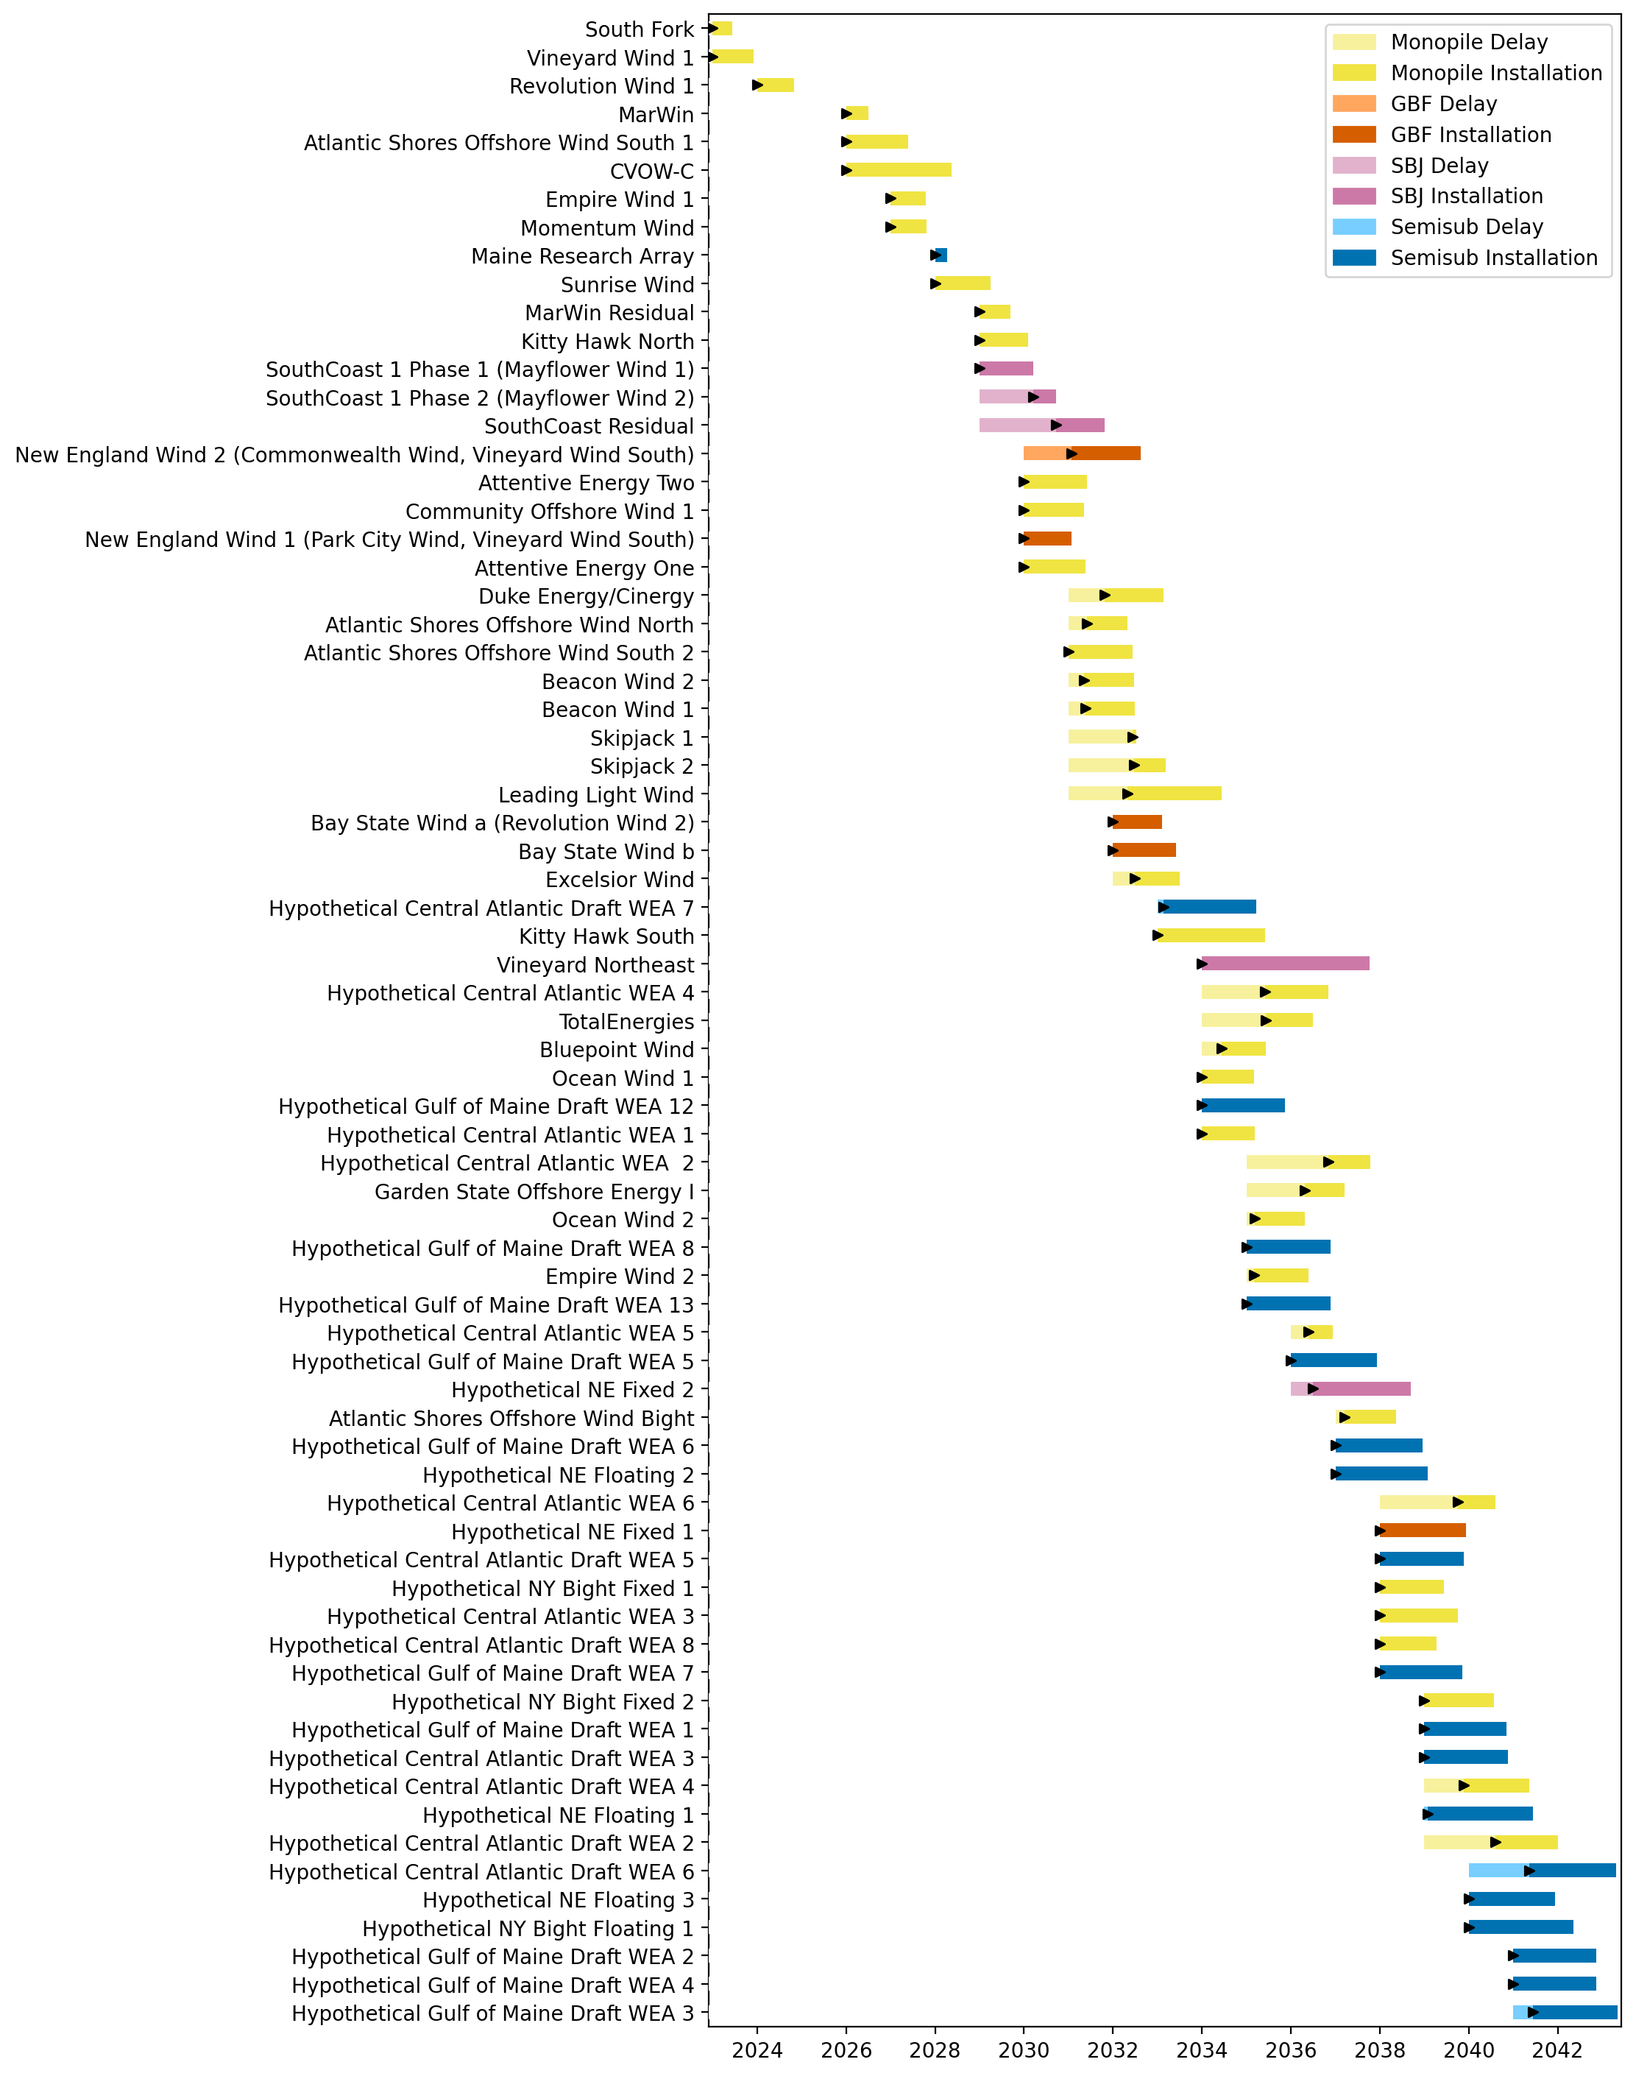
Sorted Full Gantt

Slide 24
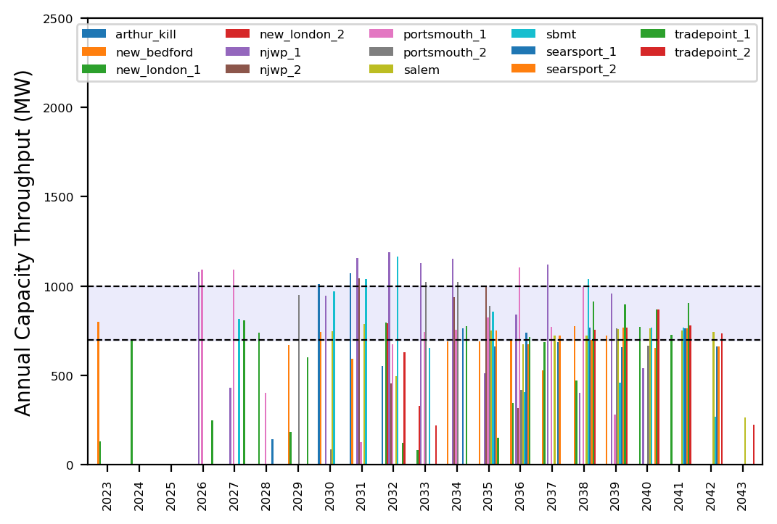
Port Throughput

Slide 25
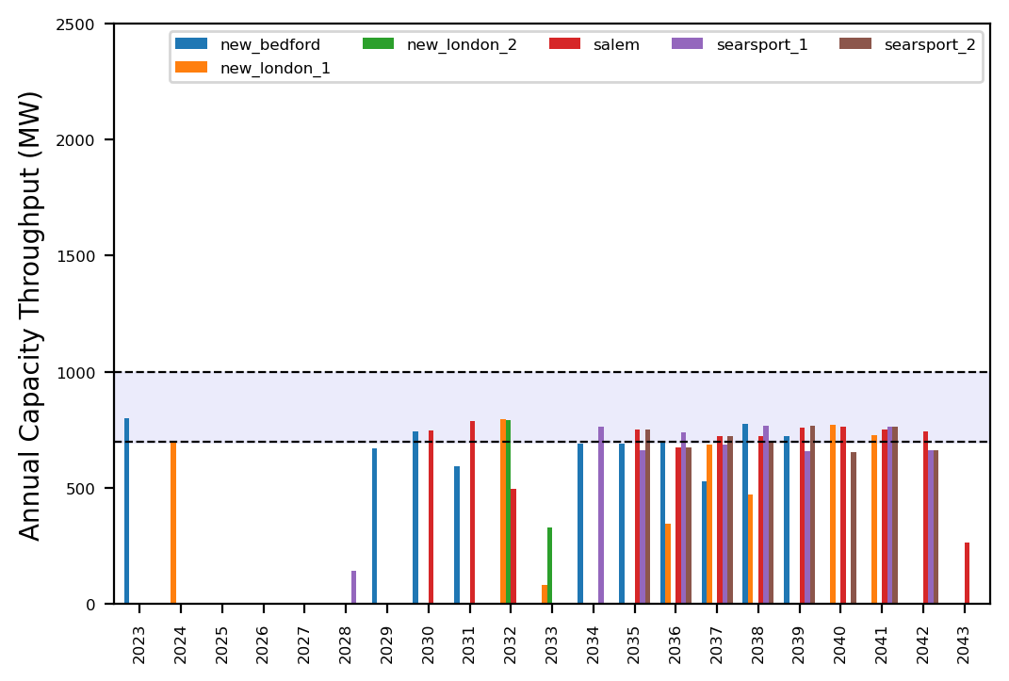
Port Throughput

Slide 26
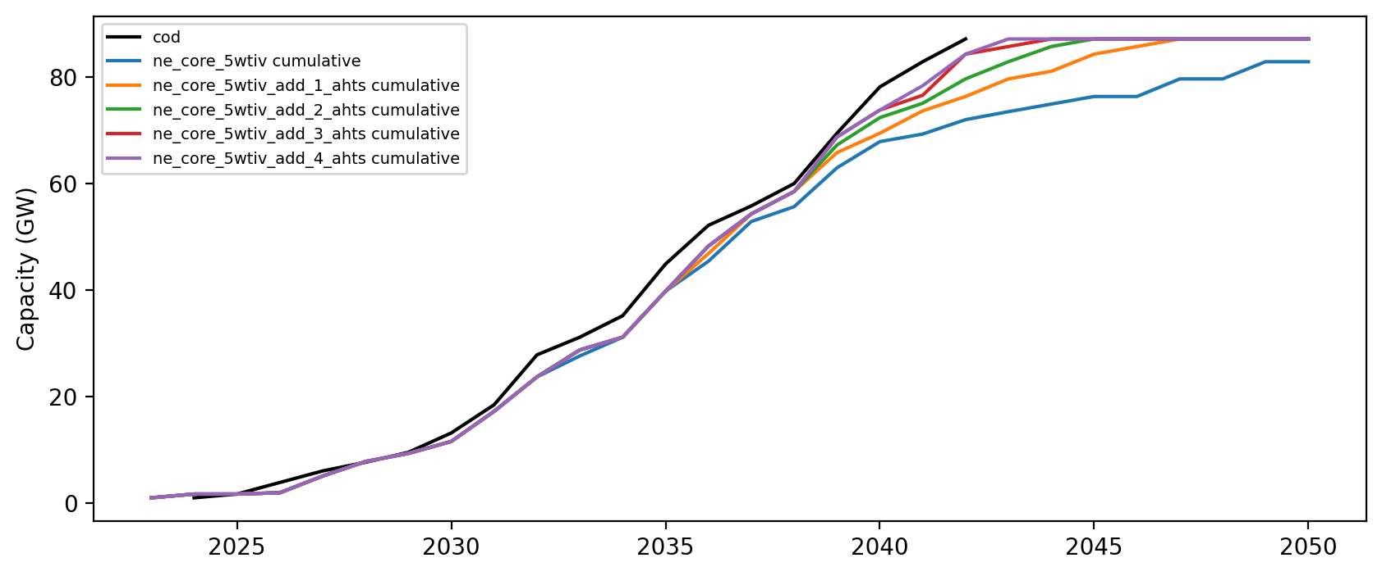
Installed Capacity

